Slide 1
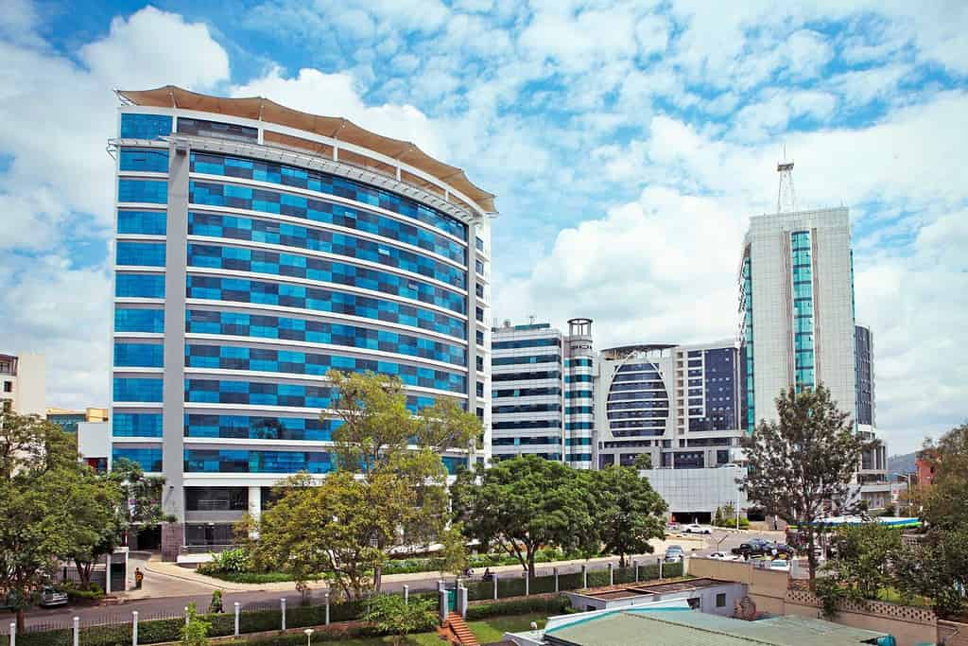
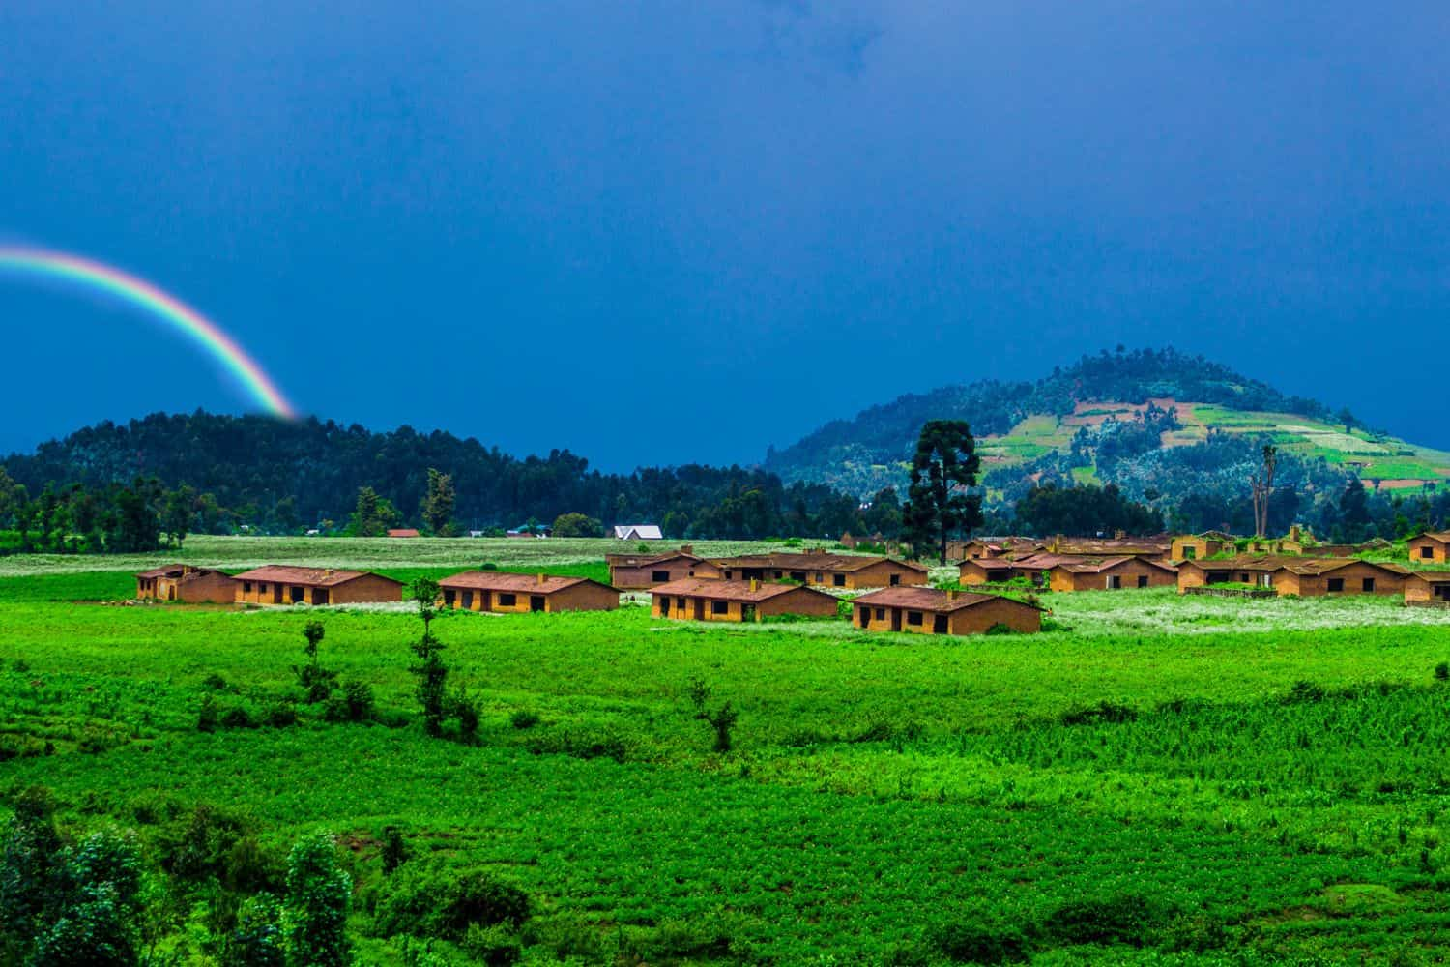
Rwanda Climate Change Risks, Mitigations, Success Stories and Opportunities
Origene Igiraneza

Slide 2
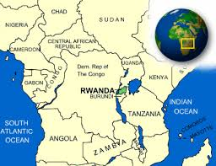
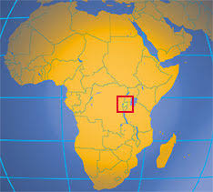
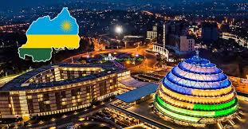
Country Overview
Rwanda is a small land locked country in Central Africa located between 1°4′ and 2°51′ south latitude and 28°45′ and 31°15′ east longitude. The country has a total land area of 26,338 km² and shares borders with Uganda to the north, Tanzania to the east, Burundi to the south, and the Democratic Republic of Congo to the west and northwest.
Rwanda is a low-income country, but still ranks as one of the top 30 places in the world easy to do business (2019) and one of the fastest-growing economies in Africa.
Rwanda has a population of 14.3 million people (2024) with an annual population growth rate of 2.5%. Approximately 17.4% of the population currently live in urban areas and this is projected to increase to 20% and 29.6% of the population by 2030 and 2050, respectively.
The country has a Gross Domestic Product (GDP) of $10.4 billion in 2019 and $10.3 billion in 2020 and an annual growth rate of 9.5% in 2019 and −3.4% in 2020.
Over the past two decades Rwanda has achieved remarkable social, political and economic progress. The Rwandan economy grew by 7.7% per year on average between 2004 and 2019, a pace exceeding those of its peers.

Slide 3
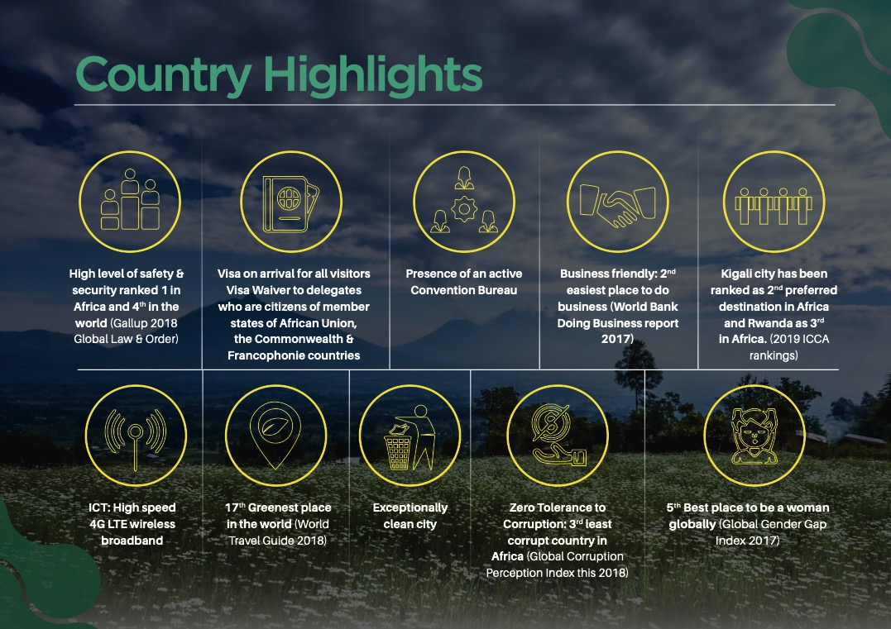
Origene Igiraneza

Slide 4
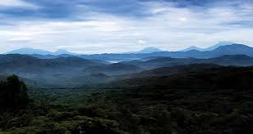
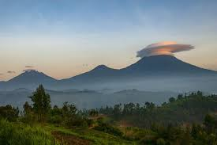
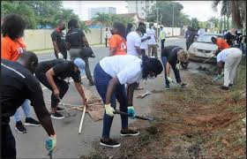
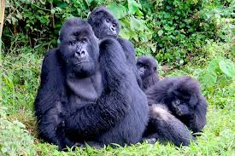
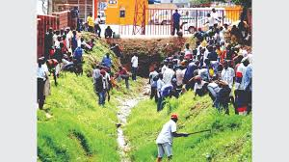
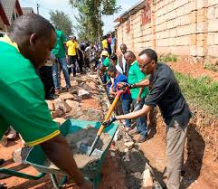
10 Facts About Rwanda
The Land of a Thousand Hills: Characterized by its hilly and mountainous terrain, Rwanda got this nickname for good reason. Rwanda’s elevation spans between the Rusizi River at 950 m above sea level to the peak of Mount Karisimbi at 4,507 m above sea level.
Home to the endangered mountain gorillas. More than half of the population of remaining mountain gorillas live in the Virunga mountains chain in the northern border of Rwanda. Thanks to conservation efforts, the mountain gorillas have increased in number in recent years.
Rwanda is the most densely populated country on the continent of Africa. In addition to mountain gorillas, Rwanda is also home to over 14.3 million people. That’s similar to the population of the state of Pennsylvania. Rwanda is one of the smallest countries on the African continent—and about a fourth of the size of the state of Pennsylvania.
No plastic bags here! Despite its dense population, Rwanda is the cleanest country in Africa. This is partly because the country banned the use of plastic bags in 2008. Tourists are not allowed to bring bags into the country, and stores will not give them out. Common alternatives to plastic bags are re-usable bags, paper bags, or biodegradable bags.
Community work day. Another reason Rwanda is so clean is thanks to Umuganda, a national holiday that takes place on the last Saturday of every month. From 8 a.m. to 11 a.m., people across the nation take part in community work to contribute to the overall national development. During Umuganda, business activity stops, and public transportation may be limited as everyone stops to contribute to their community in whatever way they can. At the end of Umuganga citizens convene together to discuss ongoing matters in their neighborhood and important government programs.
The Land of 1000 hills
Virunga mountains the home of Gorillas
Citizens cleaning streets and their neighborhood during Umuganda
People cutting glasses across water drainage during Umuganda
The President of Rwanda also participates in Umuganda

Slide 5
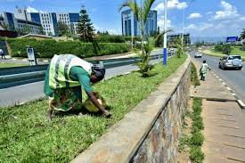
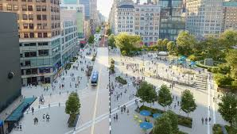
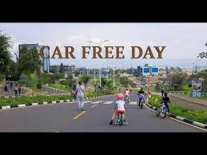
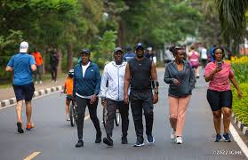
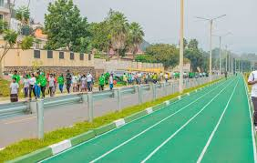
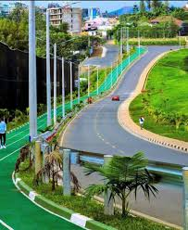
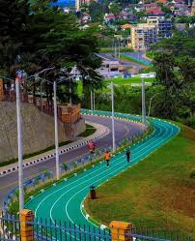
10 Facts About Rwanda (Cont..)
Kigali car-free days. In addition to keeping the streets clean, Rwandans are also working to clean their air. On the first and third Sundays of every month, major streets are closed to motorized vehicles. In addition to limiting the air pollution cased by gas-powered vehicles, people are encouraged to walk, run, bike, or engage in other healthy activities.
Car Free Zones and Public sports zones: The country introduced protected areas reserved only for pedestrians. No motor vehicles is allowed to enters those areas, free internet is provided, people can do various relaxation activities, business exhibitions, etc. In addition to Car free zones, the country also built green carpet roads reserved for people to do sports.
Rwanda has four official languages. Kinyarwanda (commonly known as Rwanda) is the national language of Rwanda. Before 1994, French was the language taught to children in schools. Since 2008, the government made the switch from French to English as the medium of education in schools. Kiswahili (commonly known as Swahili) is also taught as a subject in schools but is spoken by fewer than 1% of Rwandans.
Rwanda has Central Africa’s largest protected wetland. Akagera National Park, located along Rwanda’s eastern border, is home to over 12,000 animals. In addition to its environmental impact, the park also provides for the 300,000 people living in the surrounding areas by offering employment opportunities. In addition to working in the park, the area around the park is also the main source of Rwanda’s honey. Honey farms were established to provide an alternative income for those who previously engaged in poaching.
Women make up more than half of Parliament. In the 1990s, an average of 18% of Rwandan Parliament members were women. This number has grown. In 2003, a 30% quota was set for women in Parliament. In 2008, Rwanda became the first country in the world with a female majority in Parliament with 56%. Today, that number sits at 64%.
One of Car free zones in Kigali
Participants in Car free day
Green carpets for sports activities within the city

Slide 6
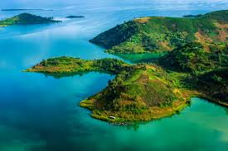
Rwanda Climate Baseline
Rwanda enjoys a tropical climate characterized by its hilly landscape stretching from east to west. The country has four primary climatic regions: eastern plains, central plateau, highlands, and regions around Lake Kivu. The Rwandan territory is covered with diverse ecosystems which includes mountain rainforests, gallery forests, savannah woodland, wetlands and aquatic forests and agro-ecosystems.
Most of the country is more than 2000 m above mean sea level, especially in the west where it breaches 3000 m. While this elevation moderates its climate, the west is highly susceptible to soil erosion. The eastern plains receive an annual rainfall of between 700 mm and 1,100 mm, with mean annual temperature oscillating between 20°C and 22°C. The central plateau region enjoys rainfall of between 1,100 mm and 1,300 mm, with an annual mean temperature of between 18°C and 20°C.
The highlands, including the Congo-Nile Ridge and volcanic chains of Birunga, benefit from an annual rainfall of between 1,300 mm and 1,600 mm and experience annual mean temperatures between 10°C and 18°C. Regions around Lake Kivu and Bugarama plains get annual rainfall of between 1,200 mm and 1,500 mm with annual mean temperatures between 18°C and 22°C.
Overall, the country’s four climactic seasons are represented through the long rainy season: March to May, and short rainy season: September to November. These seasons alternate with the long dry season: June to August, and short dry season: December to February.
Increased seasonal variability and longer-term climate change are likely to exacerbate the country’s existing vulnerabilities from high poverty, and food insecurity. Food security and progress of the agricultural sector is of primary concern as the majority of the country’s agriculture is rain-fed and produced by small-holder farmers.

Slide 7
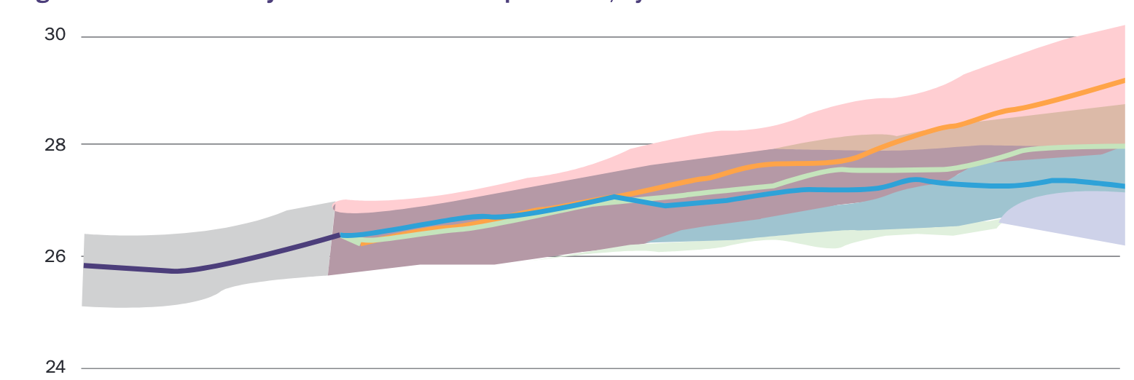
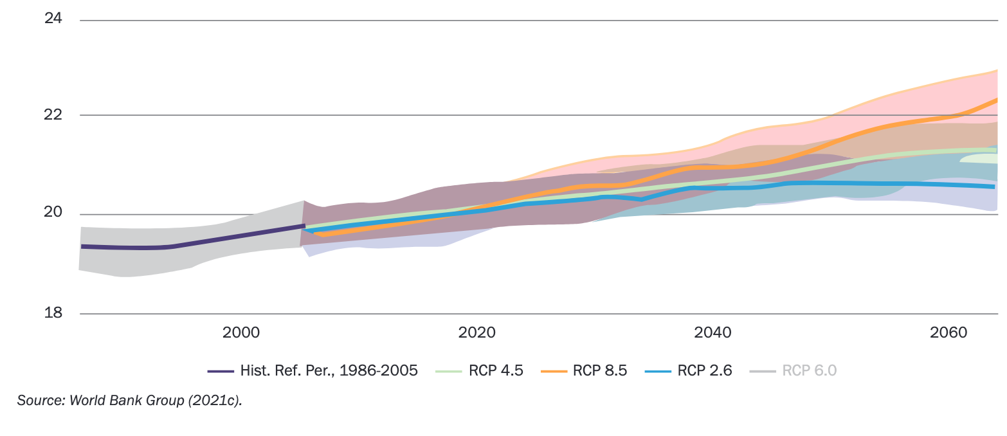
Rwanda Climate Related Risks and Hazards
Rwanda’s Projected Maximum Temperatures, by RCP
Projected changes in Rwanda’s Mean Annual Temperatures, by RCP (CMIP5)
RCP: Representative Concentration Pathway (a GHG Concentration Trajectory)
CMIP5: Coupled Model Intercomparison Project Phase 5

Slide 8
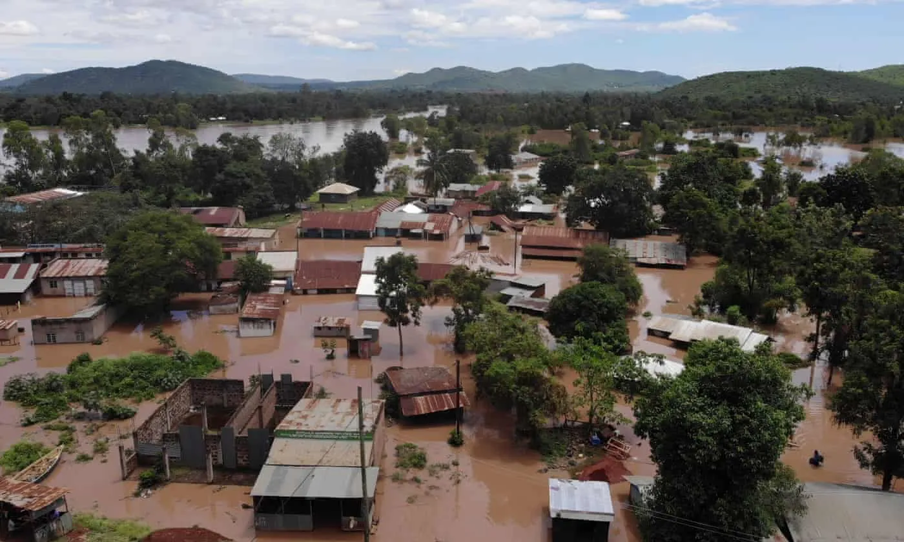
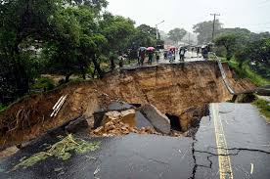
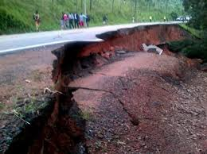
Rwanda Climate Related Risks and Hazards
While contributing only 0.003% to global greenhouse gas emissions, Rwanda is vulnerable to the consequences of climate change.
Rwanda is at risk to numerous natural hazards and include droughts, floods, earthquakes, landslides, storms (windstorms, lightning, rainstorms and thunderstorms), wildfire, diseases, and epidemics. These events have had significant impacts on the lives and livelihoods of Rwandans. Since the early 2000s, the frequency and severity of disasters, particularly caused by floods, landslides and droughts, have significantly increased, with increasing impact of human casualties as well as economic and environmental losses.
In Rwanda, the effects of flood hazards have worsened as recent population growth and land scarcity have pushed people to settle in flood-prone areas. Heavy rainfall events and at times flash flooding, have become increasingly common. Heavy rainfall events are especially common in northern and western provinces, and cause flooding, flash flood events and can trigger landslides and mudslides, leading to infrastructure damage and death. In 2015 approximately 158 million tons of topsoil were eroded, with an annual average of 62 tons per hectare. Soil erosion has increased by 54% since 1990 (NISR 2019).
Additionally, nearly 70% of Rwanda’s population is exposed to magnitude 6.0 earthquakes; 30% is exposed to magnitude 5.0 earthquakes. In 2008, two earthquakes occurred within hours of one another (magnitudes 6.1 and 5.0), killing nearly 40 people and destroying 1,201 homes in the hardest hit districts of Rusizi and Nyamasheke.
The Ministry of Emergency Management Disaster Damages report in 2020 indicated the rapidly increased national damages by climate related events. Between 2010 and 2021, Rwanda ranked 4th globally in terms of landslide events, share and the number of people affected, according to EMDAT and WDI. This ranking places Rwanda significantly higher than developed countries like the USA, China, and European nations, which are major emitters of greenhouse gases.
The impact of risks of climate change could be consequential for Rwanda’s growth given the reliance of the economy on climate sensitive sectors. Climate change is likely to increase variability in crop yields and agricultural production, cause severe flood damage to physical capital, reduce labor productivity, and impact demand for tourism. The CCDR estimates that if these risks materialize, Rwanda’s GDP levels can drop by 5–7% below baseline in multiple years by 2050, with negative impact on private consumption, exports and government revenues.

Slide 9
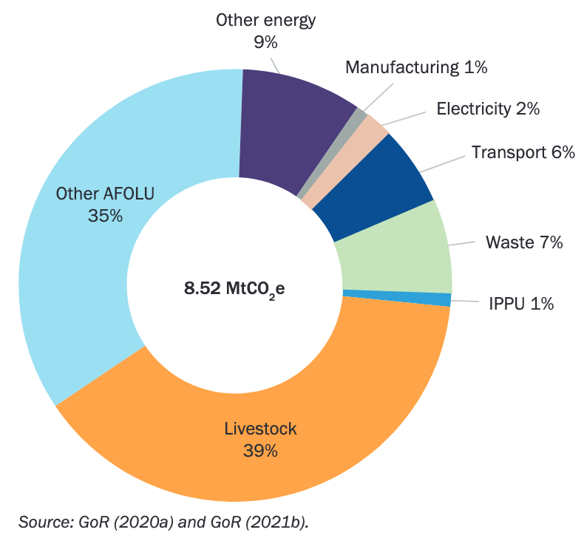
Rwanda’s Ambitious Climate Mitigation Measures
The figure below the demonstrate the total Greenhouse gas -GHG emissions (excluding removals) of 8.52 MtCO₂e for 2015. The removal of emissions by forestry was estimated at about 6.7 MtCO₂e. Therefore, the net emissions for 2015 are estimated at 1.86 MtCO₂e.
The Government of Rwanda recognizes that sustaining high growth rates will require building resilience to different shocks, including those stemming from climate change. The country has prepared ambitious measures to support a green, inclusive, responsible, and growth-orientated development pathway. These adaptation and mitigation measures are outlined its 2020 revised Nationally Determined Contribution (NDC) together with costed investments, programs, and policies.
All measures are carefully designed to mutually reinforce adaptation and mitigation objectives, and contribute to meeting Rwanda’s development objectives. For example, measures classified as mitigating emissions from livestock, agriculture, and land use (which together account for 74% of total emissions), include investments in conservation agriculture, animal husbandry, and soil and water conservation, which will also increase Rwanda’s resilience to climate shocks.
Six high-priority areas have been identified namely: Human capital development; Export dynamism and regional integration; Well-managed urbanization; Competitive domestic enterprises; Agricultural modernization; and Capable and accountable public institutions.
The government of Rwanda has implemented various policies and initiatives to mitigate the effects of climate change. The following slides provides more details about the initiative and policies enacted since two decades ago, those range from Policy and Strategy initiatives; Renewable Energy and Low-Carbon Development, Sustainable Urban Development; Agriculture and Land use; Conservation and Biodiversity; Waste Management and Recycling; and Community Engagement and Education.
Some policies such as barning the importation of second hand clothes (regionally known as CAGUWA) to promote locally made green texturing industry, made some developed country unhappy and yielded to stopping economic support to the country and affected its projected growth rate.

Slide 10
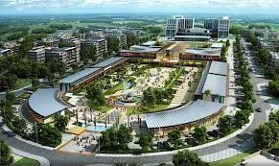
Rwanda’s Climate Change Mitigation Success Stories
Nationally Determined Contributions (NDCs): Rwanda committed to a 38% reduction in greenhouse gas emissions by 2030 under the Paris Agreement.
National Climate Change Policy (NCCP): A policy framework guiding all sectors in climate mitigation and adaptation efforts.
Green Growth and Climate Resilience Strategy (GGCRS): A roadmap integrating climate resilience and low-carbon development.
National Adaptation Plan of Action (NAPA): Prioritizing vulnerable sectors like agriculture, water, and energy for climate adaptation measures.
Environment and Climate Change Fund (FONERWA): Africa's largest national climate fund financing green initiatives.
Policy and Strategy Initiatives

Slide 11
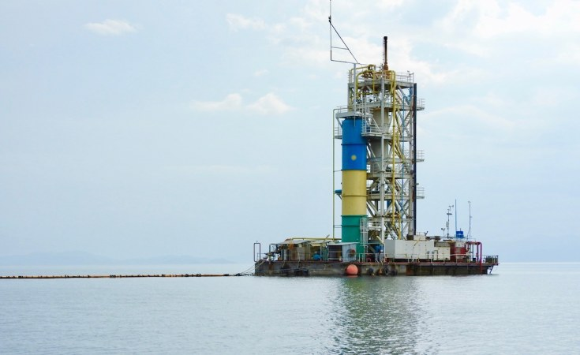
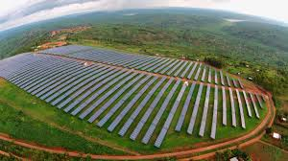
Rwanda’s Climate Change Mitigation Success Stories
Hydropower Development: Investing in hydroelectric dams to reduce reliance on fossil fuels..
Solar Energy Expansion: Deployment of off-grid solar systems in rural areas and solar power plants like the Gigawatt Global Solar Field.
Methane Gas Extraction: A roadmap Harvesting methane gas from Lake Kivu for clean energy production.
Improved Cookstoves Program: Disseminating efficient stoves to reduce firewood and charcoal use..
Bioenergy Promotion: Supporting biogas production in households and institutions to replace wood-based fuel.
Renewable Energy and Low-Carbon Development

Slide 12
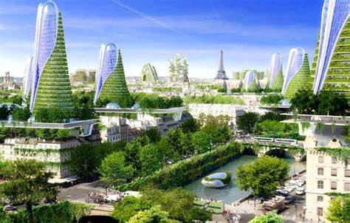
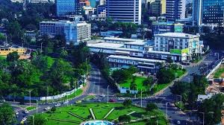
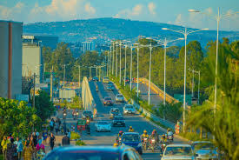
Rwanda’s Climate Change Mitigation Success Stories
Kigali Green City: An eco-friendly urban development model incorporating renewable energy, green building technologies, and waste management.
Integrated Public Transport System: Expanding public transport and introducing electric buses and motorcycles.
Non-Motorized Transport: Expanding public transport and introducing electric buses and motorcycles.
Smart Cities Framework: Using technology for energy-efficient urban planning and operations.
Sustainable Urban Development

Slide 13
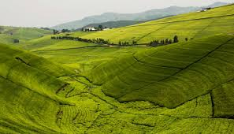
Rwanda’s Climate Change Mitigation Success Stories
Agriculture and Land Use
Land Husbandry, Water Harvesting, and Hillside Irrigation Project (LWH): Reducing soil erosion and promoting sustainable agriculture.
Agroforestry Programs: Encouraging tree planting on farms for carbon sequestration and soil fertility.
Climate-Resilient Agriculture: Promoting drought-resistant crops and sustainable farming practices.
Terracing and Reforestation: Large-scale land terracing and afforestation projects to combat soil erosion.
Organic Fertilizer Promotion: Reducing synthetic fertilizer use to cut emissions and improve soil health.

Slide 14

Rwanda’s Climate Change Mitigation Success Stories
Restoration of Gishwati-Mukura National Park: Rehabilitating degraded forest ecosystems and improving biodiversity..
Bamboo for Climate Resilience: Promoting bamboo plantations for carbon capture and soil stabilization.
Wetland Restoration: Protecting and restoring wetlands for water filtration and carbon storage.
Akagera Solar Power Plant: Supporting conservation through renewable energy use in protected areas.
Conservation and Biodiversity

Slide 15

Rwanda’s Climate Change Mitigation Success Stories
Waste Management and Recycling
Zero Waste Policy: Promoting waste separation and recycling at the source.
Kigali Waste-to-Energy Project: Converting landfill waste into clean energy.
Ban on Single-Use Plastics: Strict regulation on plastic bags and single-use plastic products. Rwanda was one of the first countries in the world to ban single-use plastics.
E-Waste Recycling Facilities: Safe disposal and recycling of electronic waste.

Slide 16
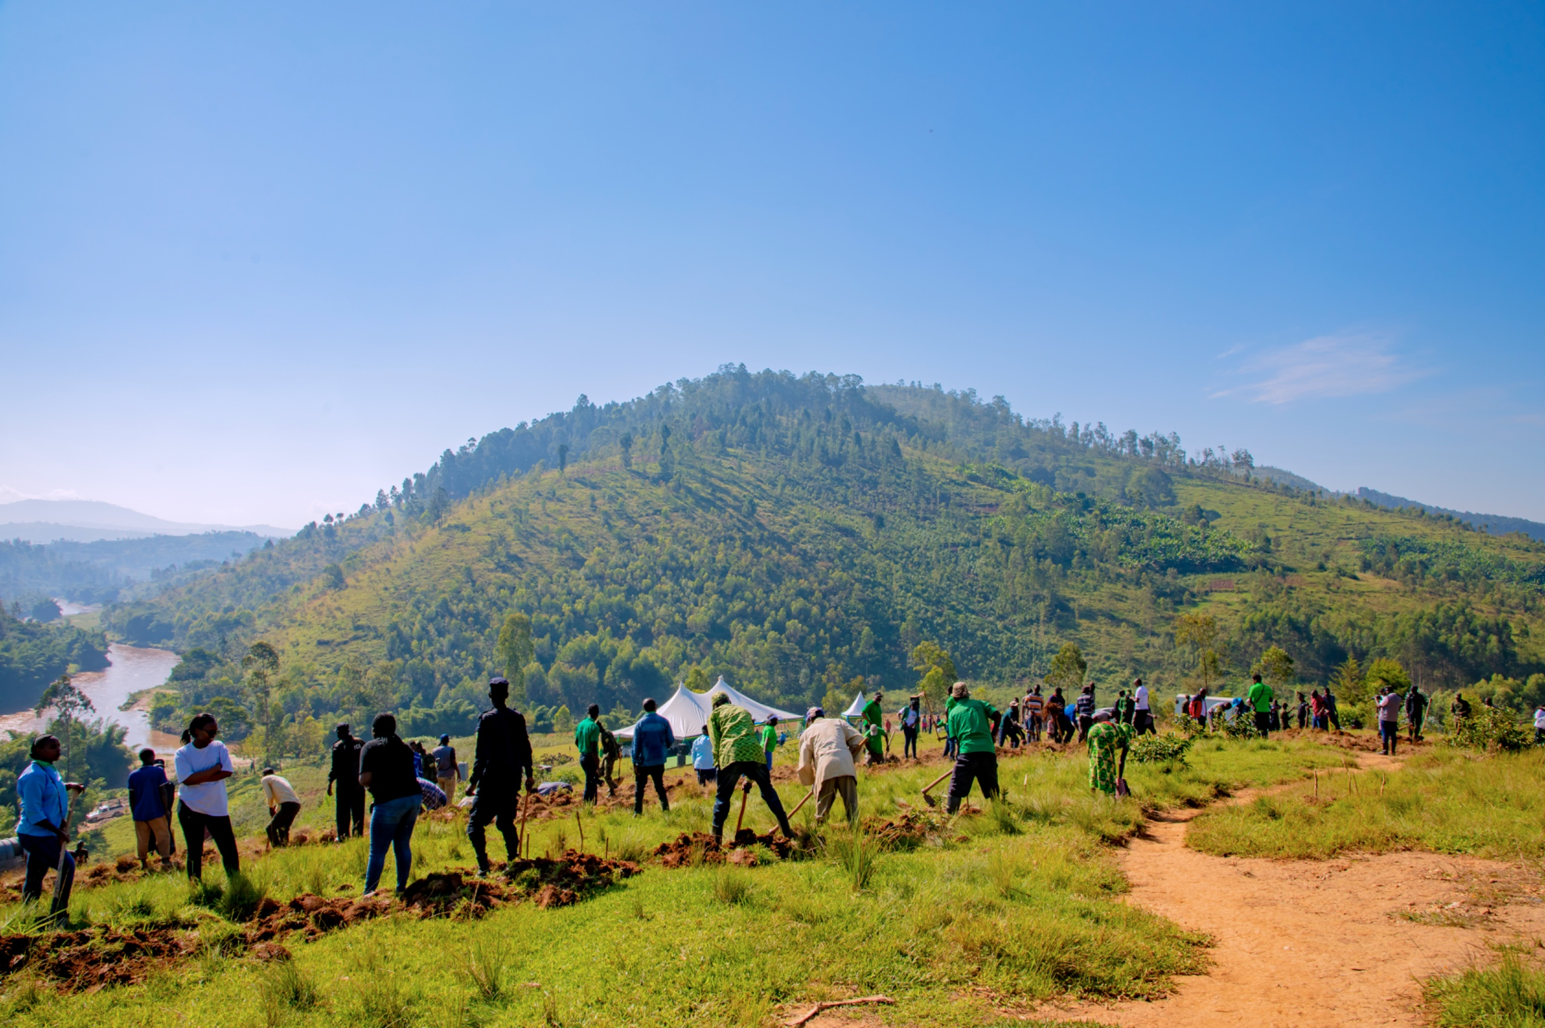
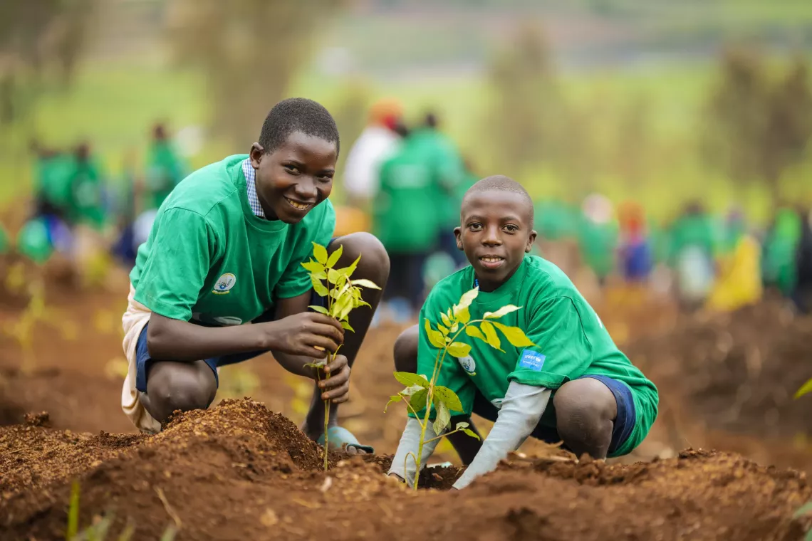
Rwanda’s Climate Change Mitigation Success Stories
Green Rwanda Initiative: Public campaigns on tree planting and environmental awareness.
Umuganda for Climate Action: Monthly community service days focusing on environmental protection.
Climate Education in Schools: Mainstreaming climate change awareness into the national curriculum.
Community Engagement and Education

Slide 17

Thank You!
Origene Igiraneza
origene_igiraneza@gse.harvard.edu
https://www.linkedin.com/in/igiraneza-origene/

